Slide 1
Goal Driven Decision Making

Slide 2
Goal Driven Decision Making
Clear goals can enable sub teams, leaders, and individual team members to make the day-to-day decisions that logically lead toward accomplishing team goals & missions.
Teams should have an overall "mission" to use as a guide for everything they do every day.
Team goals should all be in service of achieving the team's mission.
Team projects, trainings, meetings, and day-to-day activities should directly contribute to accomplishing the team's goals.

Slide 3


Tools For Decision Making As A Team
MCW Prioritization
SMART Goals
Consensus Building & Blameless Culture
Subjective & Objective Thinking
Understanding &
Allocating Resources

Slide 4
MCW Prioritization
MCW Prioritization can be used as a tool to sort nearly anything, including projects, tasks, actions, & goals.
Defining what you WILL do can be just as important as defining what you WILL NOT do. Doing both these steps are critical to reduce ambiguity and confusion in decision making.
M | Must Have: Non-negotiable features/objectives
C | Could Have: Nice to have features/objectives that will have a small impact if left out
W | Will Not Have: Features/objectives that are not a priority

Slide 5
Subjective & Objective Thinking
Subjective
Objective
Based on or influenced by personal feelings, preferences, or opinions
      Qualitative
Considering and representing with facts and data. Not influenced by opinions or feeling.
      Quantitative
Subjective Data Examples
-Cleanliness of pit -Bumper quality -Electrical/mechanical robustness -Maneuverability -Driver skill -Robot ability
Objective Data Examples
-Number of game pieces scored -Auto routine -Number of batteries -Balanced in end game -Robot weight -Drivetrain type

Slide 6
Understanding & Allocating Resources
  Mutual understanding of your team's resources enables team members
MONEY | TIME | KNOWLEDGE | SPACE
Robot Budget Shipping expenses - faster costs more Small batch vs large batch COTs/stock orders How quickly can you access your money? | Your most valuable and limited resource How often do you meet? What is completed individually outside of meetings? Build Season Schedule Part fabrication | From Students From Mentors/Coaches Offseason preparations Machining capabilities Previous competition experience External Resources | In-house fabrication capabilities Organization How many people can reasonably work at same time? Is meeting time limited due to location? Practice Field

Slide 7
Consensus Building
Blameless Culture
The process of consensus building can sometimes take more time than voting/etc. but ensures team members are generally aligned on decisions, which saves time long term.
Making decisions via votes or similar can lead to team members feeling unheard or disregarded.
Allows opportunity for a more open & honest discussion of perspectives.
Creating a "blameless culture" involves establishing that failures, mistakes, and errors are typically a result of processes, and never individual people.
Mistakes are normal and will be made no matter what we do.
Enables teams to discuss and identify areas for improvement without assigning blame.

Slide 8
SMART Goals
  Developing goals that meet all the "SMART" categories allows teams to more clearly communicate, track, and evaluate a goal's success and completion.
S | M | A | R | T
Specific | Measurable | Attainable | Relevant | Time-Bound
Set goals with appropriately narrow scopes using real metrics. | Define what evidence will prove you are making progress. | Goals should be challenging but possible. | Goals should be clearly related to our team mission, values, and subteams. | Goals should have deadlines.

Slide 9
SMART Goals
Goal:
Scout as many robots as possible.
SMART Goal:
Scout all robots in all practice, qualification, and elimination matches at Sunset Showdown
In most cases, teams should be able to more clearly define what "as many as possible" means for their team, allowing the goal to be more 'Measurable'.
Goal:
More team members able to proficiently use machines.
SMART Goal:
10 assembly students green-dot certified on 3 Basic Machines by end of season.
If a team sets out to accomplish "more" of something, teams should be sure to reflect on their starting point. This allows the team to set an 'Attainable' but challenging goal.
Goal:
Win the Creativity Award.
SMART Goal:
Win a robot attribute award at the Clackamas District Event.
Over-defining, or being too 'Specific', in your goals can cause similar difficulties to under-defining goals. Over-defining can cause teams to miss goals that are otherwise very attainable.

Slide 10
Team-Wide Goal Setting Activity
Define Goal Scope
Select Activity Date
Create Goals
1
2
3

Slide 11

Team-Wide Goal Setting Activity
      Among a subset of team members (lead coaches, mentors, student leaders, etc) define what areas your team will be developing goals for and how many goals per area.
      This allows members to create relevant goals.
May Goal Setting Activities may be more focused on creating goals related to Team Processes, Summer & Fall Training/Projects, New Member Recruitment, Offseason Competitions, and Community Involvement.
December Goal Setting Activities may be more focused on creating goals related to District/Regional Competitions, Build Season Timelines, Subteam Outputs, and Robot/Award Performance.
EXAMPLES

Slide 12

Team-Wide Goal Setting Activity
      Select & share the date for team-wide goal setting with the whole team as early as possible.
      Share which areas you will be developing goals for (Goal Scope)
        If team members can't attend, consider creating a way for missing members to contribute their ideas ahead of time.

Slide 13

Team-Wide Goal Setting Activity
      Divide into groups of 4-6 team members.
        Small teams ensure everyone is heard.
        Create diverse groups (age, experience, specialty) allowing range of perspectives.
      Share the Goal Scope along with the importance & process of SMART goal setting with the team.
      Begin creating goals. Give groups a reasonable amount of time to create a limited number of goals in each defined area.
      Each group should share their goals with the team.
        If goals are particularly contradictory, you may consider discussing them as one large group to build consensus among the team. Be sure to document the goals.

Slide 14
Example: Team-Wide Goal Setting Activity
1. Discuss and write down SMART goals as a group (20 minutes):
2-3 team goals for the 2026 season
2-3 subteam/project goals for the 2026 season
2. Discuss and write down SMART goals as a group (20 minutes):
2-3 team goals for District Events
1-2 team goals for District Champs
1 team goal for World Champs
3. Write down SMART goals individually (will be turned in):
2-3 personal goals for yourself, for the 2026 season on the team.
Turn in your individual goals to a coach and get started on project work!

Slide 15
Goal Approval Process
Once goals have been created through a Goal Setting Activity, they should be combined, evaluated, then approved or declined. This process should be completed among a subset of team members, which will vary from team to team. This group may be a combination of lead coaches, mentors, student leaders, etc.
1. Combine & Categorize Goals
Similar goals should be combined to minimize redundancy in preparation for the next step.
2. Evaluate Goals
Each goal should be evaluated and/or modified individually, applying the "SMART" principles.
3. Share Final Goals & Reasoning
The final approved goals should be shared with the entire team early and often.
Goals may need to be further sorted to allow for quicker evaluation, particularly for similar but contradictory goals.
Example: Rank in the top 3 at District Championship & Rank in the top 5 at District Championship
In particular, the goal should be evaluated for Attainability and Relevance. If the goal is not Attainable & Relevant, it should be modified or declined.
Reasoning for declining goals should be discussed and documented.
Reasoning should be shared for declined goals or groups of declined goals, even if brief, to ensure mutual understanding and buy-in with the approved goals.

Slide 16
Goal Follow Up
It is important that goals are revisited regularly to ensure progress is being made toward achievement. There are several ways teams can follow up with their goals which may include:
Post:
Check:
Evaluate:
Reflect & Celebrate:
Build:
Goals are posted or shared in a location where team members can view them at least once a week.
The team holds a monthly "goal check-in" meeting to understand progress and modify goals if needed.
After each competition/event, the team evaluates if they met their competition/event goals and how.
At the end of the season, the team holds a "season reflection" meeting to discuss whether they met their goals and other successes or areas for improvement that may lead to future goals. It’s always good to celebrate even the smallest of goals.
When setting goals for the upcoming season, the team refers to their previous season's goals to have a better understanding of what is attainable.

Slide 17
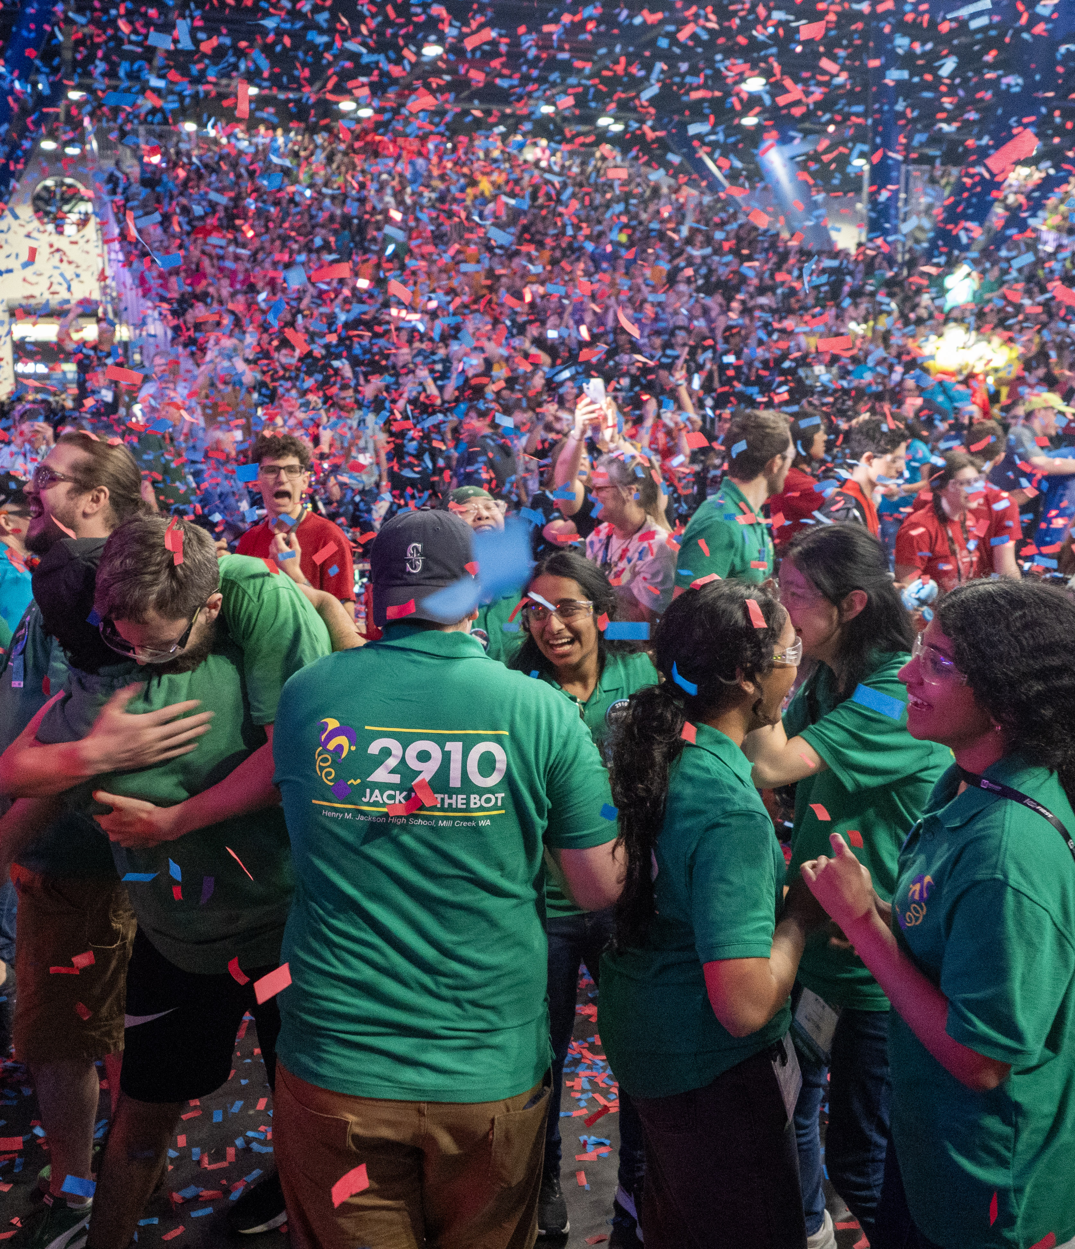
Key Takeaways
Clear goals provide direction, alignment, and a shared basis for decision-making across the team.
Effective goals are SMART: specific, measurable, attainable, relevant, and time-bound.
Strong goals reflect team resources, past performance, and desired growth - not just aspirations.
Progress should be tracked with metrics and revisited regularly throughout the season.
Goal setting should be inclusive, blameless, and focused on learning as much as on specific outcomes.
Reviewing and celebrating goals, whether met or missed, drives continuous improvement year to year

